Slide 1
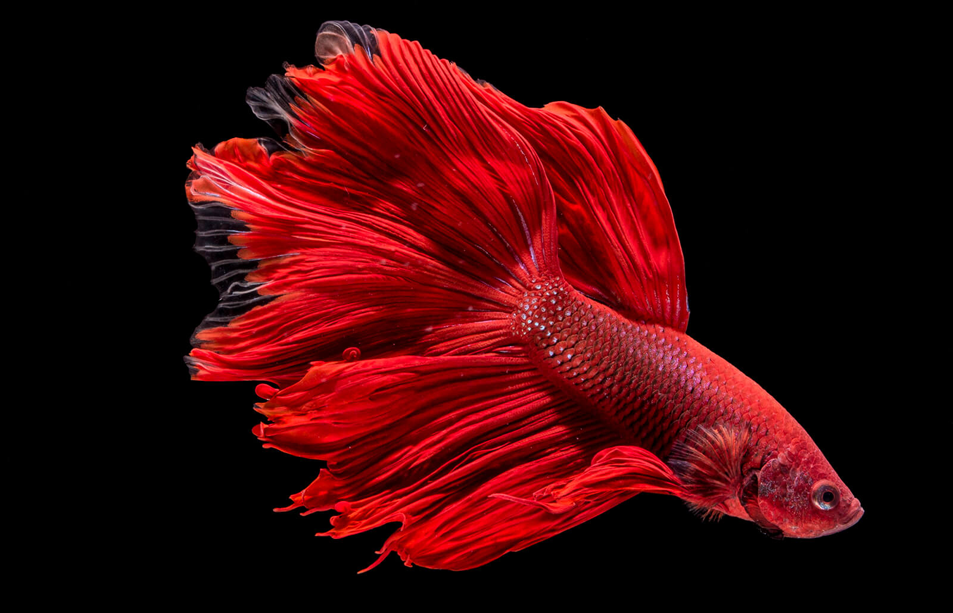
Computer Engineering
Melanie Fuhrmann
Nathan Paskach
Cyber Security Engineering
Isabella Leicht
Adan Maher
Electrical Engineering
Sarah Degen
Brandon Mauss
Software Engineering
Jack Croghan
Feederal Reserve
Team 43
Notes:
Bella

Slide 2
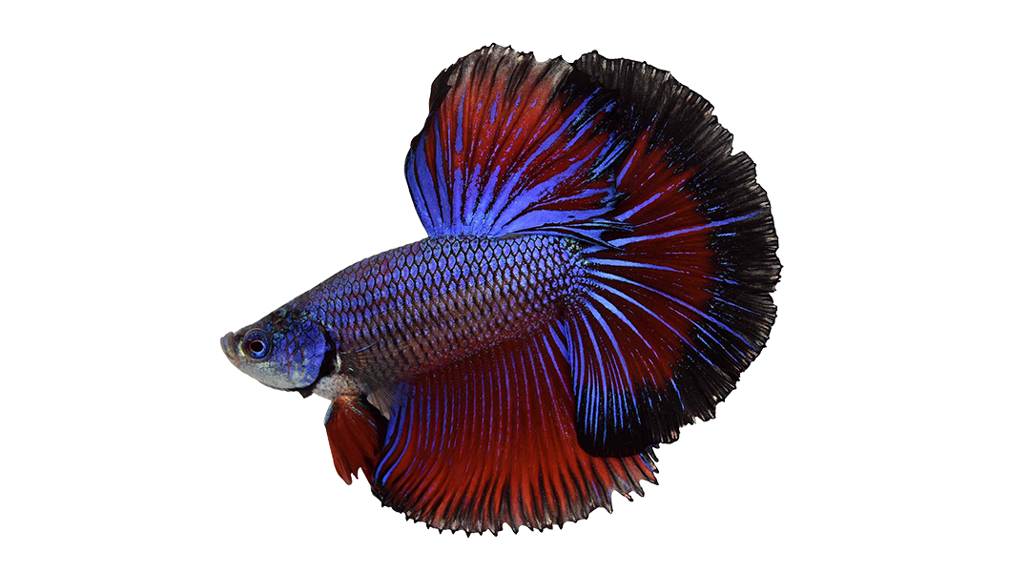
Problem
Problem: Must feed the fish when caretakers are not present
Current market feeders dispense too much food for one fish
Alternative options (such as slow release tablets) can cause dangerous water conditions
Fix: A device with the following requirements
Dispenses a specified volume of fish food (pellets)
Uses an app to remotely control the device
Monitors and displays water conditions
Notes:
Bella

Slide 3
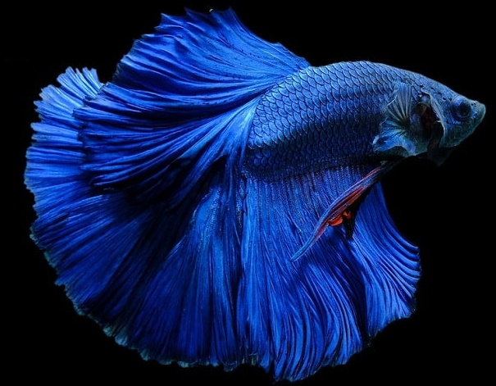
Requirements
Dispensing Device
Dispense 3 pellets at a time
Store 1 week of food (approx 25 pellets)
Sensors
Measure temperature (±1°F)
Measure acidity (±0.1pH)
App
Give alerts for out of range values
Display tank conditions (temperature, pH, when they were last fed)
Set up feeding schedules
Notes:
Adan

Slide 4
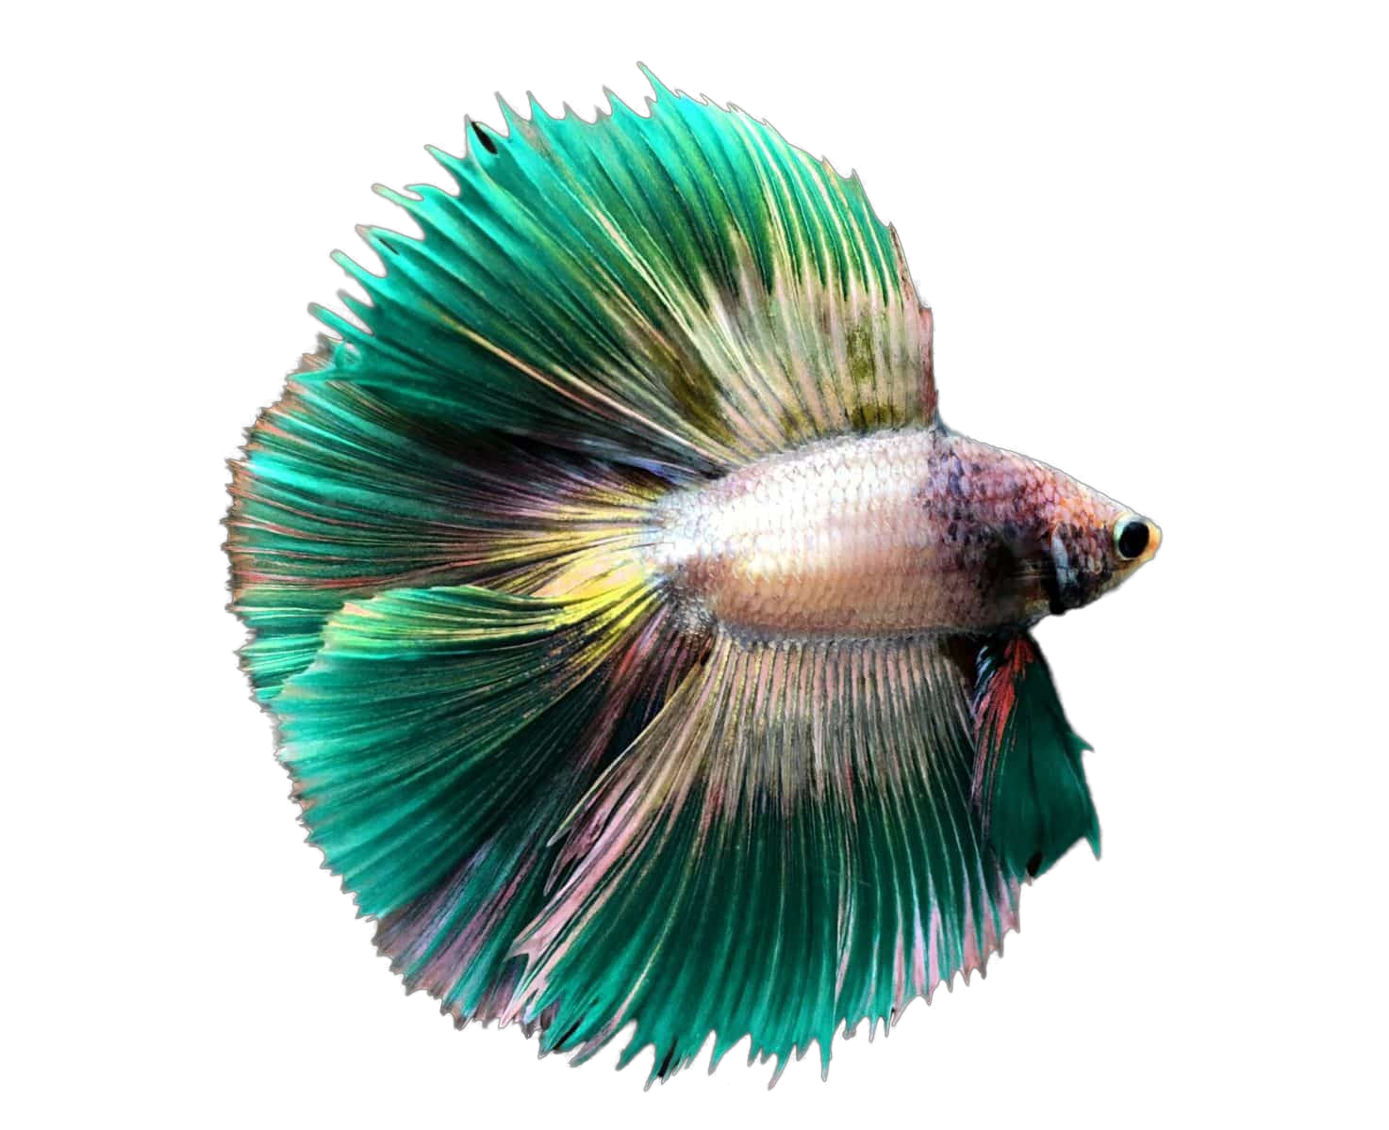
High-Level Diagram
Food Hopper
iPhone/ Computer
Flask Server
Dispensing Mechanism
Food presence sensor
MySQL Database
pH sensor
Temperature
sensor
Notes:
Adan

Slide 5
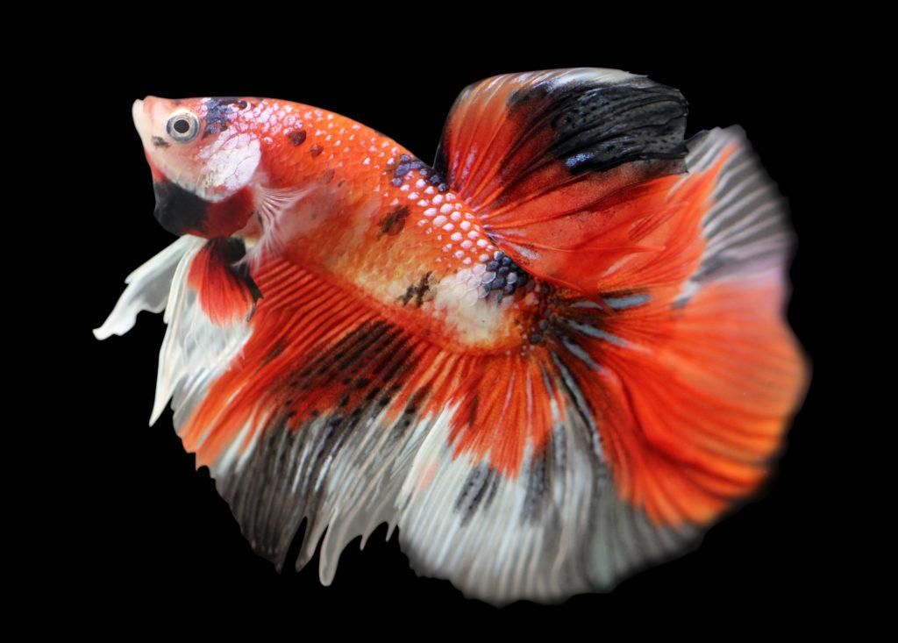
User Interface Designs
We are creating an app that works on both iOS and Web, for ease of use for the client/users.
We need to provide the following pages:
Dashboard showing each device with sensor data, when the fish were last fed, and quick-feed button
Schedules showing created schedules and an indication of which one is currently in use if any
Create Schedule where the user can create and name a new schedule
Settings page where user can select color theme
–When the tank was last cleaned/schedule– stretch goal
Notes:
Melanie

Slide 6
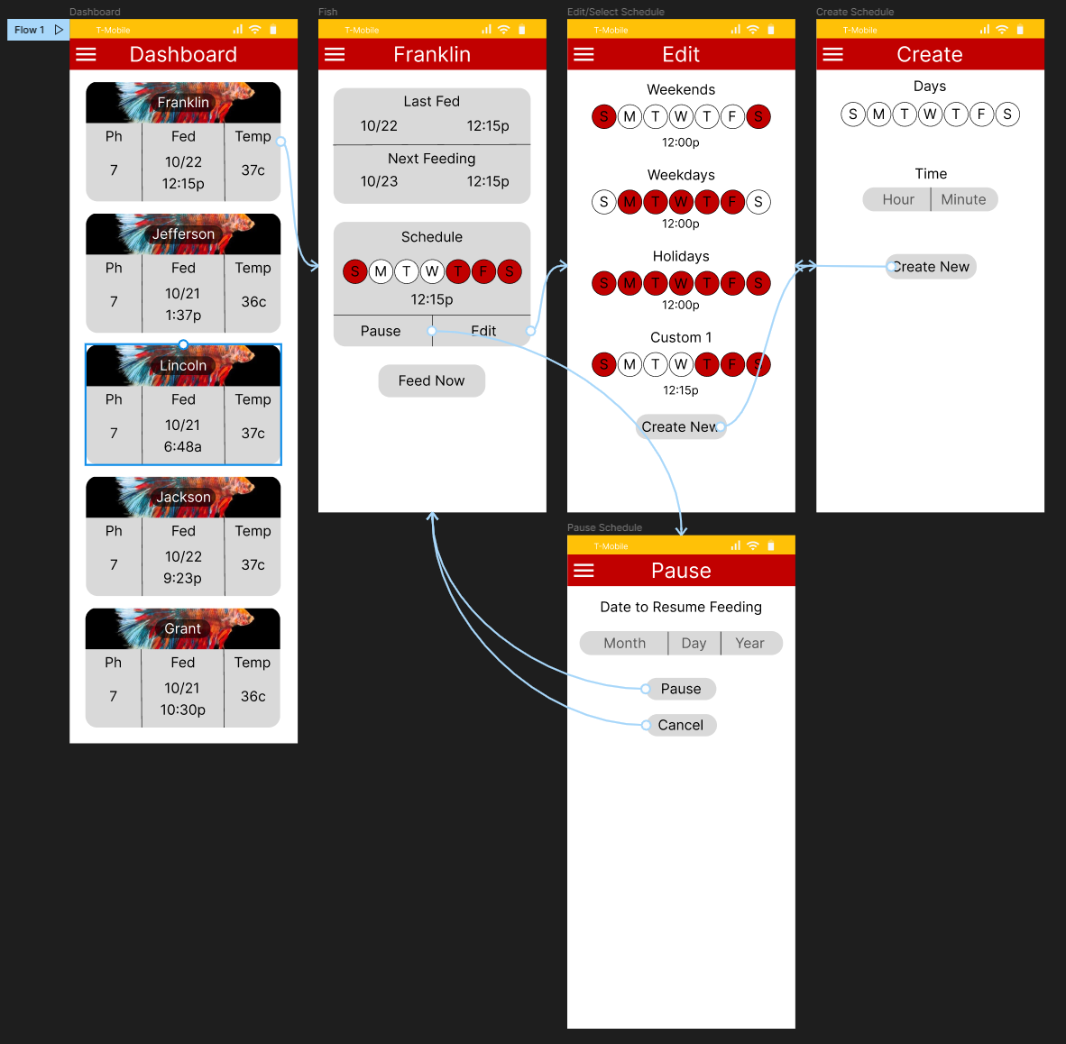
User Interface
Web and iOS for user ease
Pages for:
Dashboard
Edit Schedule
Create Schedule
Pause/Delay schedule
Device Current Schedule
Stretch Goal:
Display tank cleaning schedule/ when water was last changed
Notes:
Melanie

Slide 7
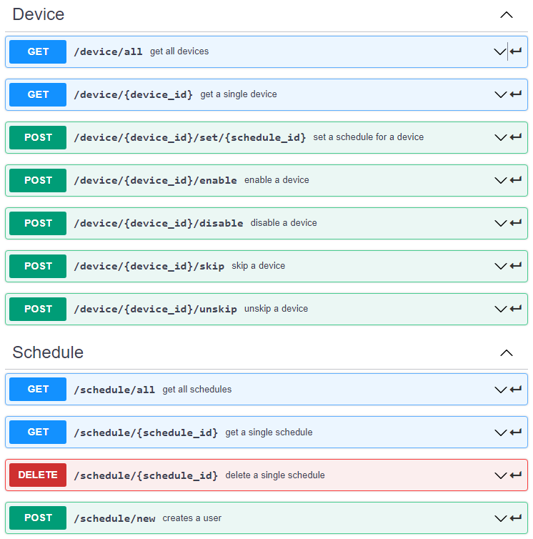
API
Created to ease the development of the front and back end individually
Separated based off of what each route modifies or retrieves
Easily adjustable for future growth
Created in postman to keep everything centralized
Notes:
Jack

Slide 8
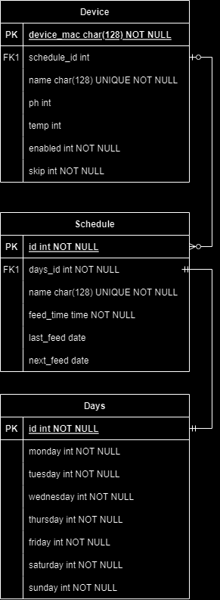
Database Structures
MySQL database connected using SQLAlchemy
Device
Device mac used to identify each connection
Name must be unique
Schedule is not required
Schedule
Days ID references the days that a schedule can execute
Last and next are only ever set if a schedule is going to be used
The name must be unique
Notes:
Jack

Slide 9
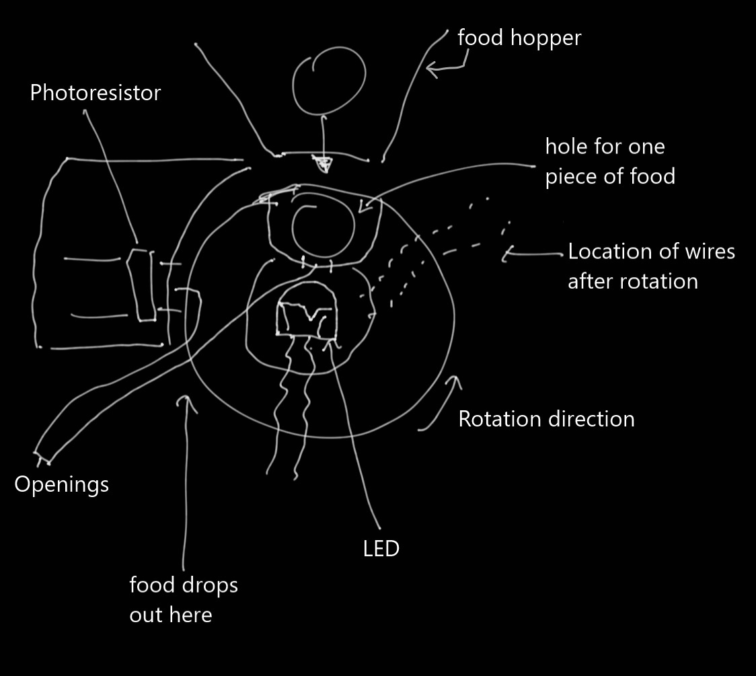
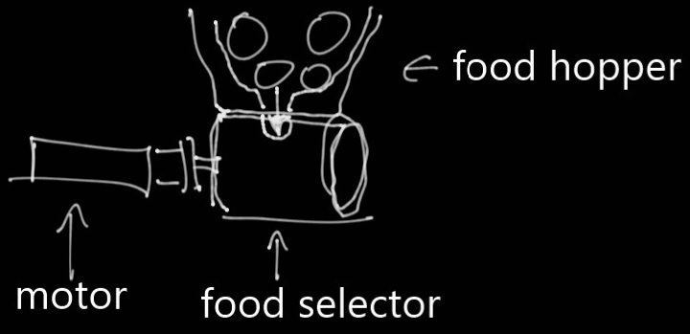
Feeding Mechanism Designs
Inside
Outside
Design not chosen
Notes:
Brandon

Slide 10
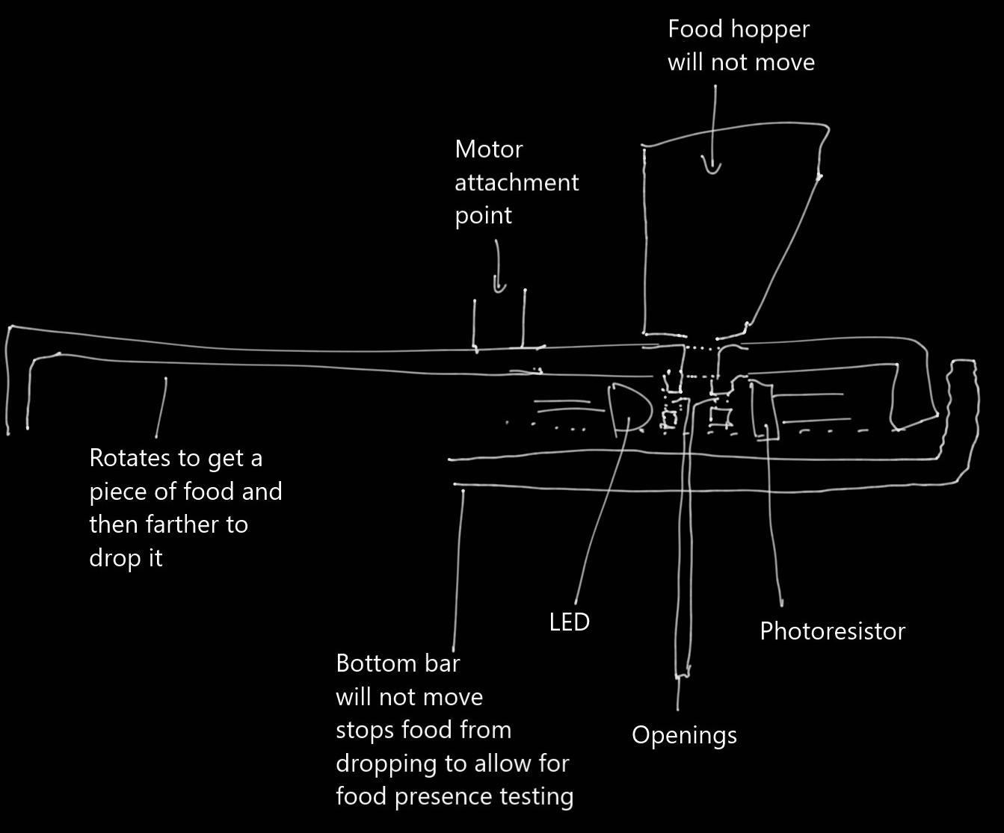
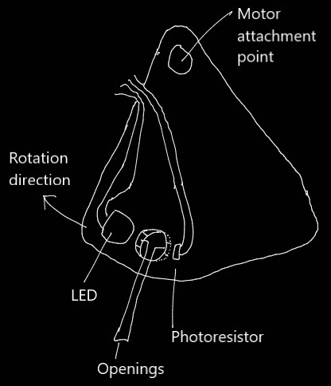
Chosen Design
Version 2
Only rotating section changed
Version 1
Notes:
Brandon

Slide 11
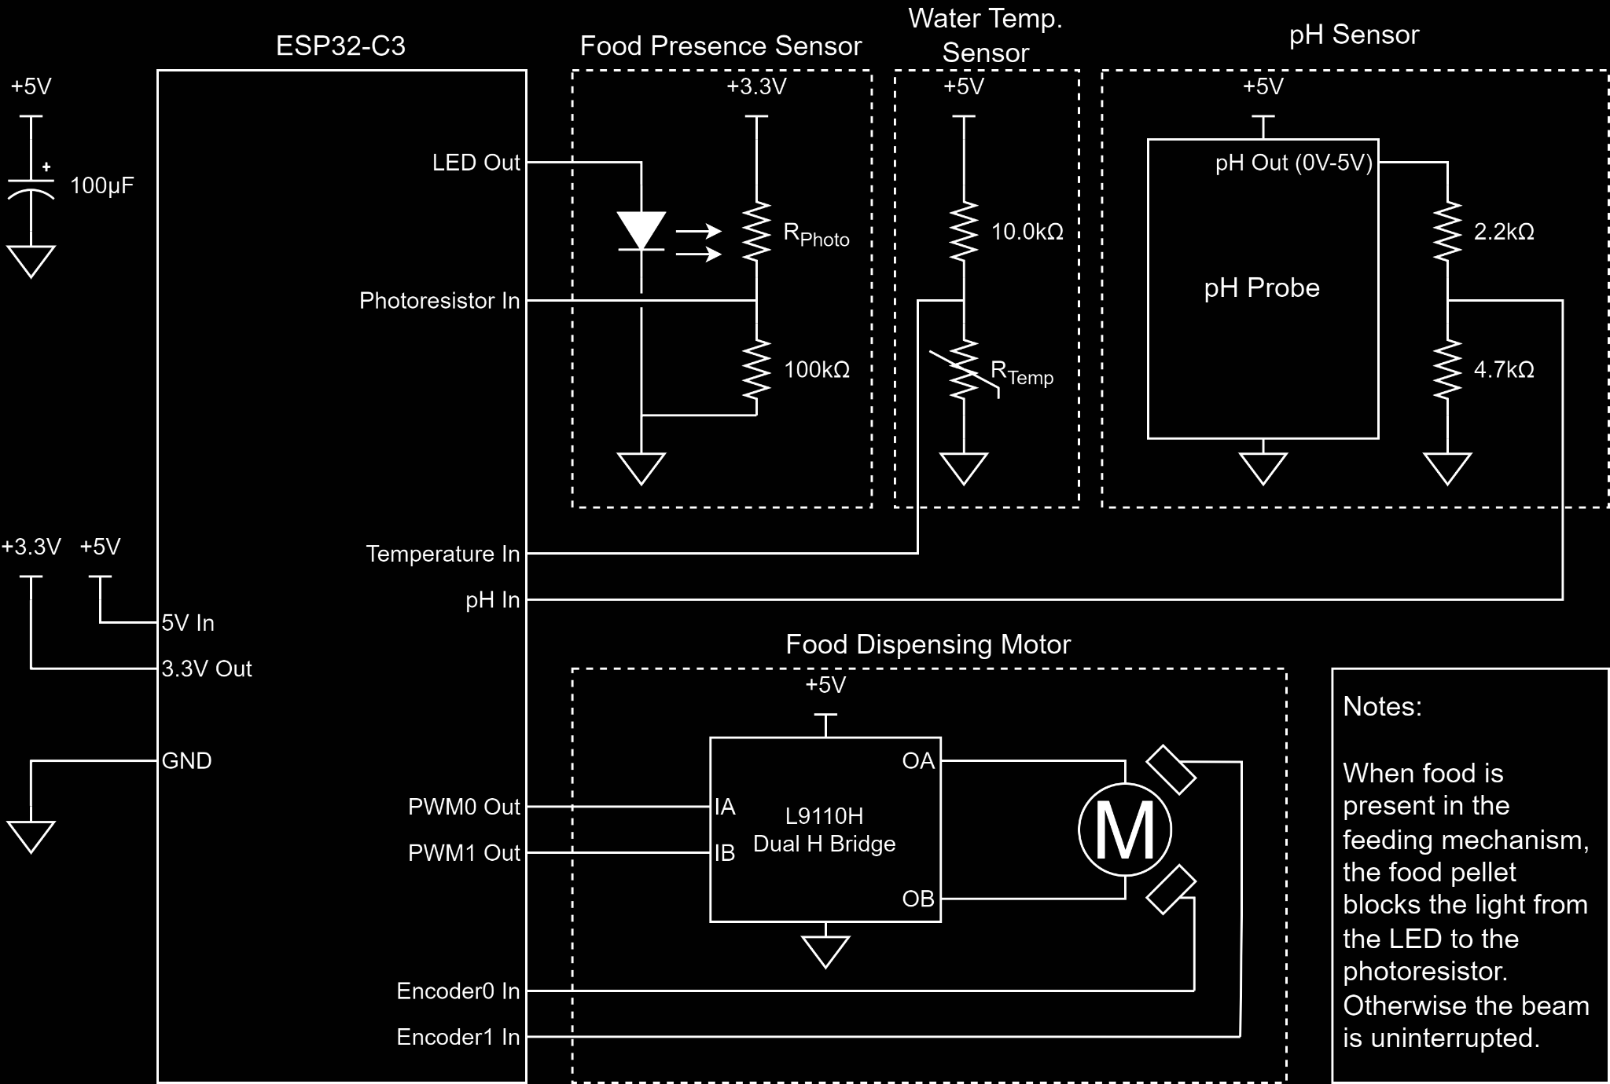
Proposed Circuit Design
Notes:
Nathan

Slide 12
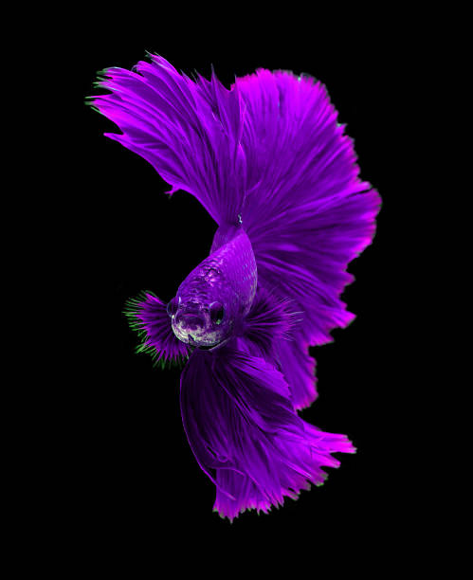
Testing Plan
Mechanism
Test and calibrate sensors
Test feeder design to ensure drops one pellet at a time
Test for light percussive security (hammer time)
Frontend
Ensure navigation is correct and intuitive
Test frontend sends and receives data from backend/server correctly
Give preliminary design to clients for client feedback and input
Test against injection attacks
Backend
Ensure TLS cert implementation
Notes:
Sarah and Melanie

Slide 13
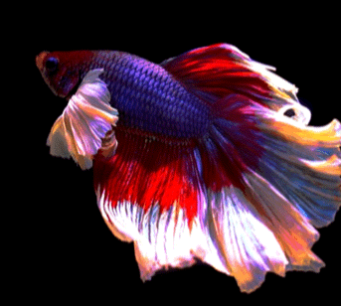
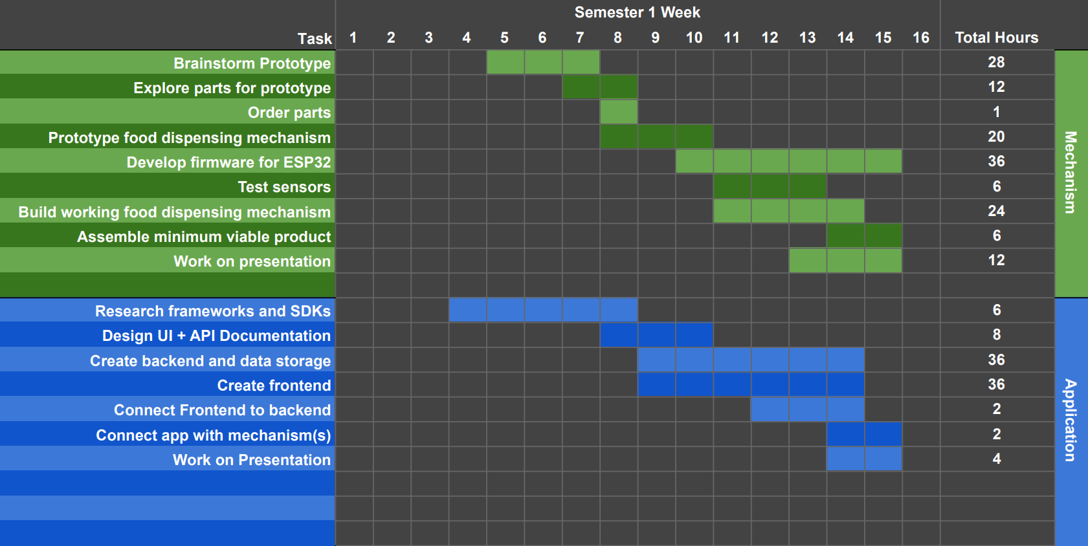
First Semester Gantt Chart
Notes:
Sarah

Slide 14
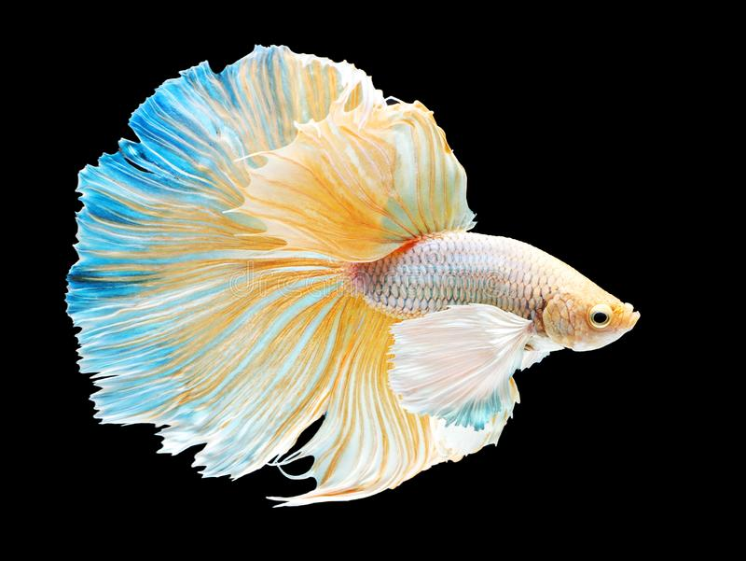
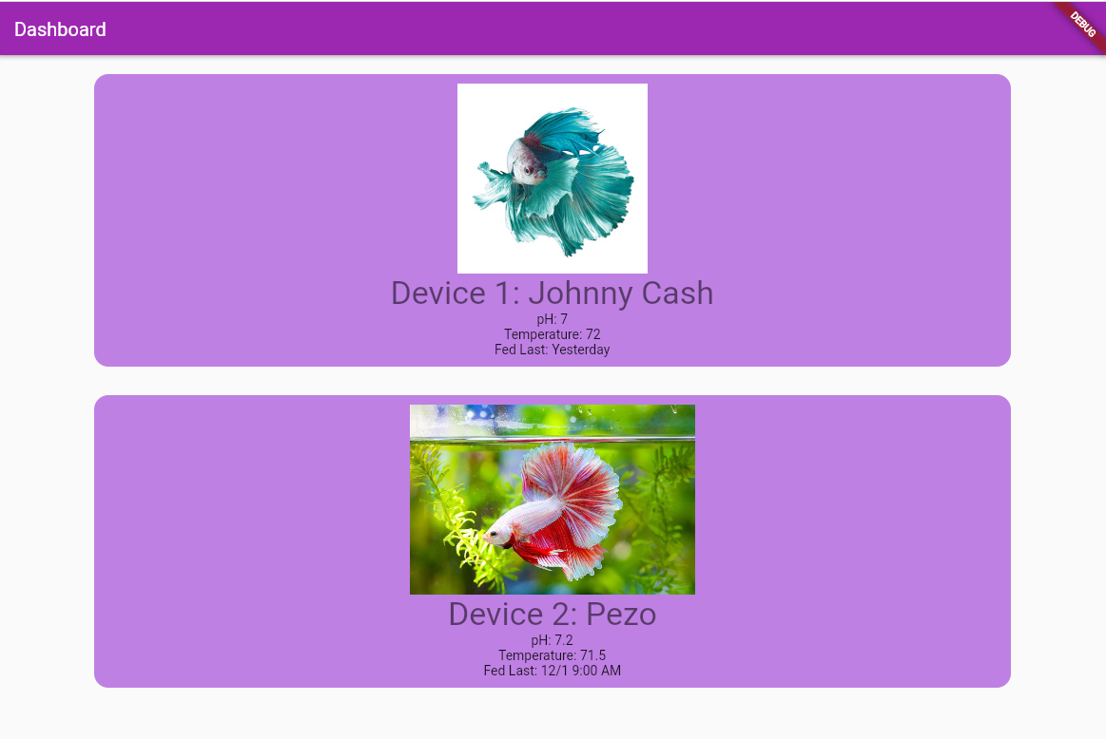
Current Implementation Status
Mechanism
Prelim hardware created on protoboard
Prototype firmware written
Sensors have been calibrated
Case parts being drawn up in CAD
Software
Server requested and acquired
Backend API implemented
Frontend dashboard/home page created
Notes:
Sarah and Jack/Melanie

Slide 15
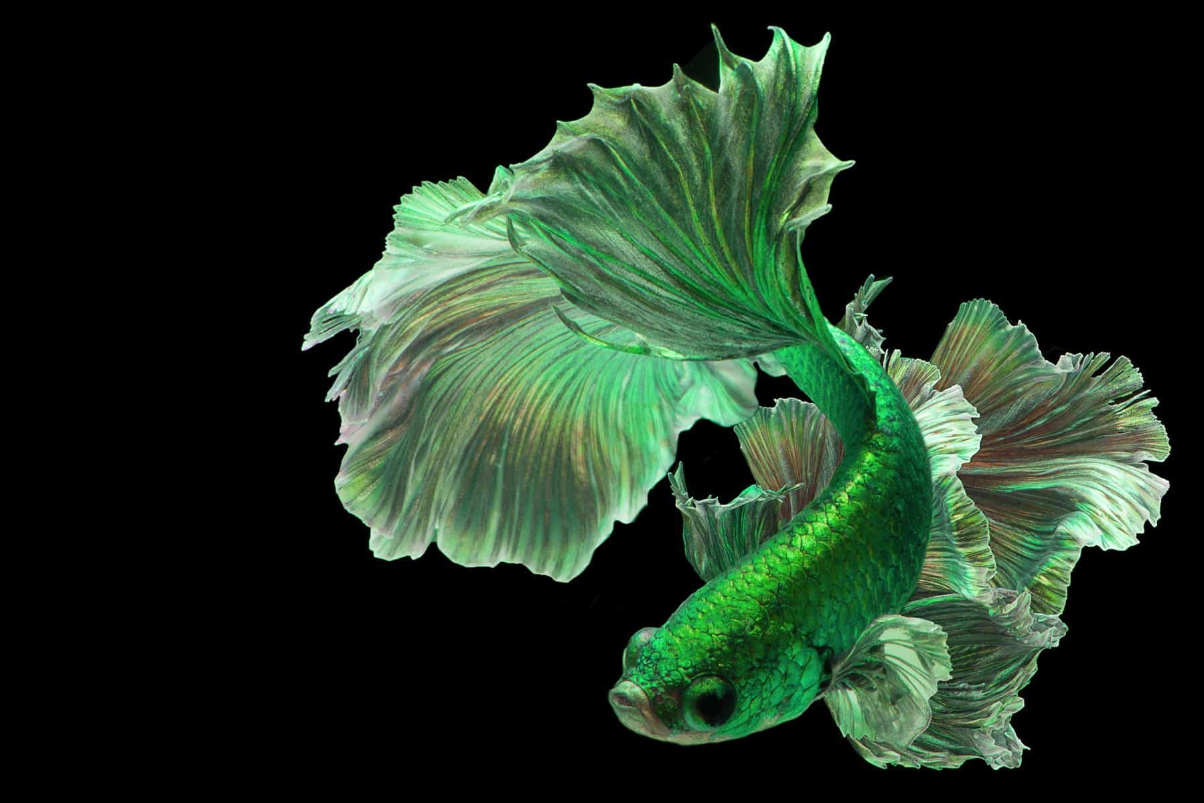
Goals for Next Semester
Mechanism
Final design and integration
Build own pH sensor circuit
Build case
Implement physical security features
Field and functionality testing
Stretch goals
Salinity sensor
Hold up capacitor for power loss detection
Software
Final design and integration
Implement software security features
User and functionality testing
Stretch goals
Table/page for indicating tank cleaning schedule
Store a history of data readings from the tank
Notes:
Nathan for mechanism and Melanie/Jack for software

Slide 16
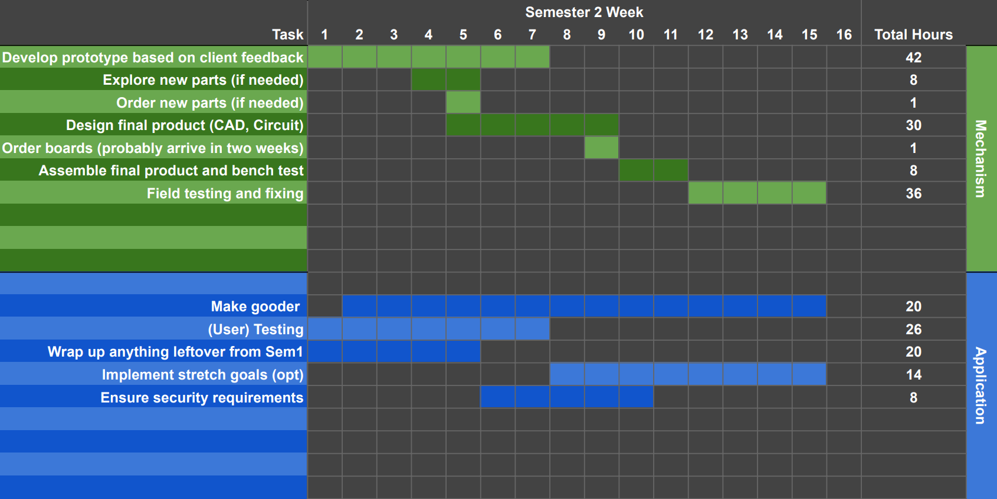
Second Semester Gantt Chart
Notes:
Melanie

Slide 17
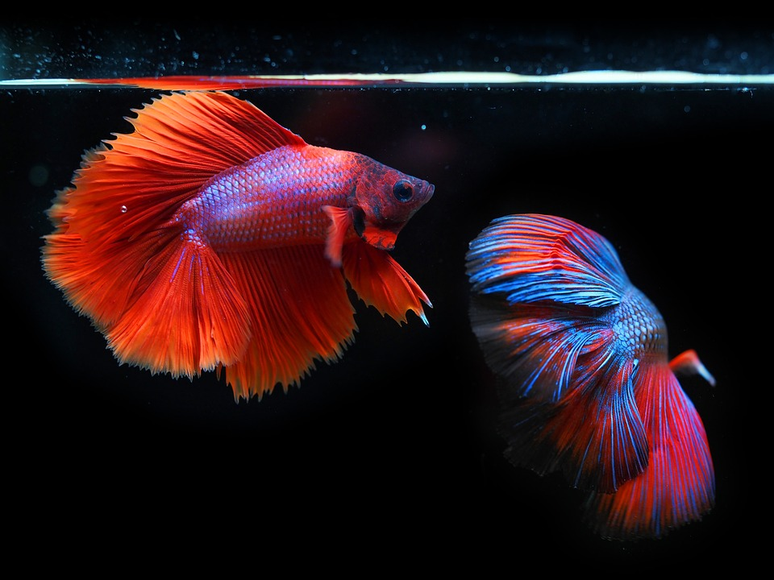
Fin

